Slide 1
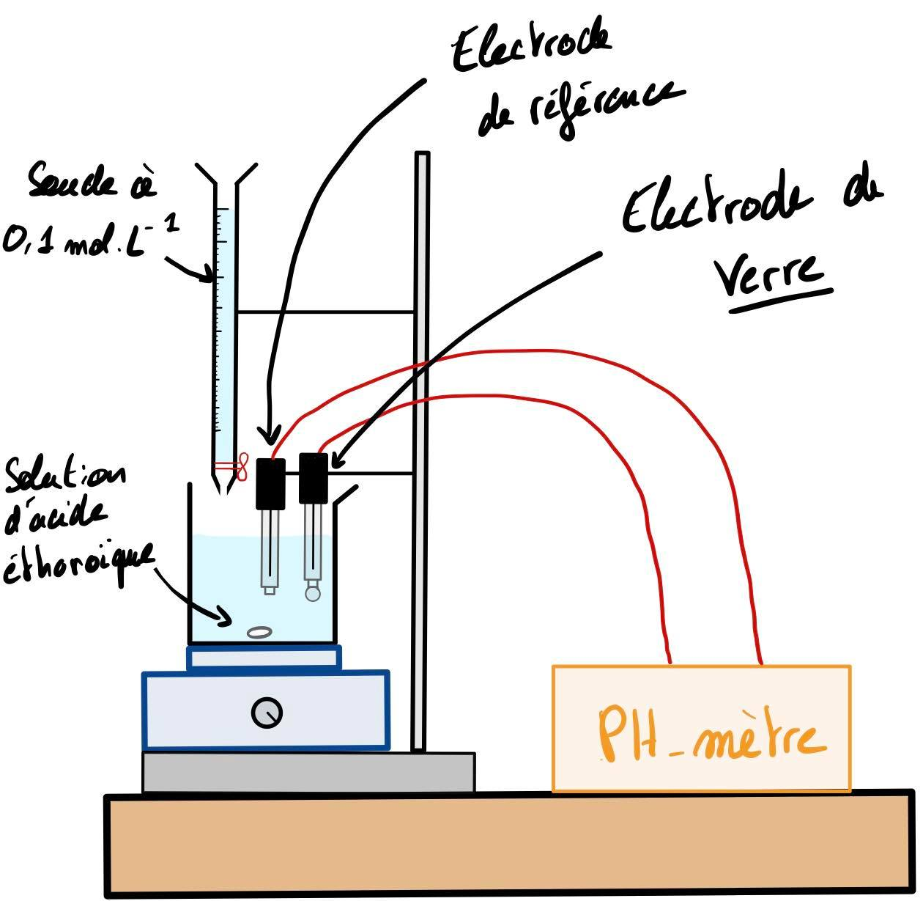
Détermination du pKa du couple :
$$CH_{3}COOH_{\left(aq\right)}/CH_{3}COO_{(aq)}^{−}$$
$$CH_{3}COOH_{\left(aq\right)}+OH_{\left(aq\right)}^{−} →CH_{3}COO_{\left(aq\right)}^{−}+H_{2}O_{\left(l\right)}$$

Slide 2
$$pH=pKa+log⁡(\frac{\left[A^{−}\right]}{\left[AH\right]})$$
$$pH=pKa+log⁡(\frac{\left[CH_{3}COO_{(aq)}^{−}\right]}{\left[CH_{3}COOH_{(aq)}\right]})$$

Slide 3
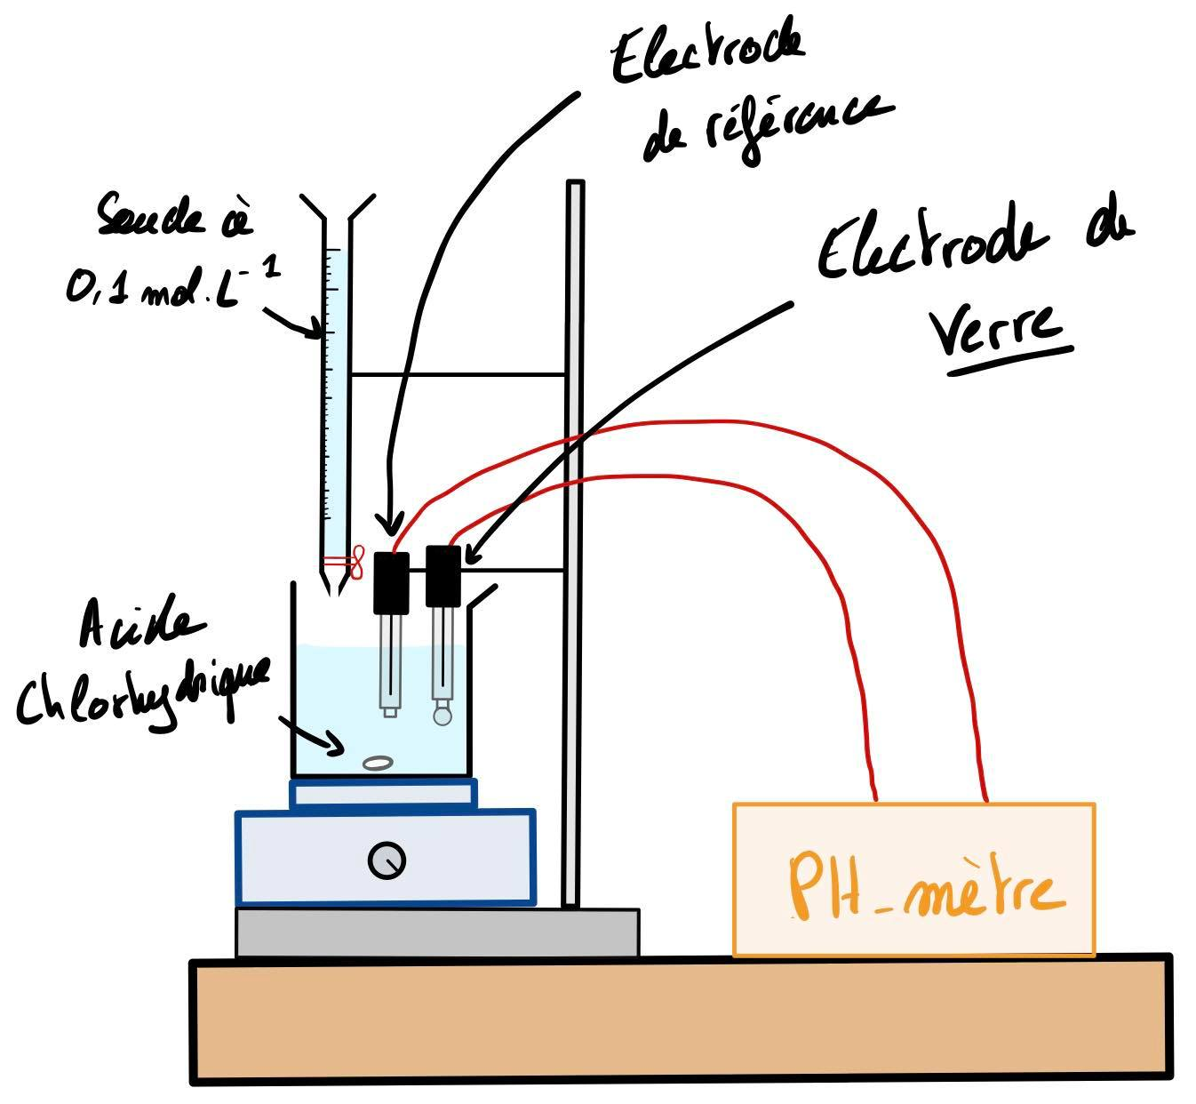
$$H_{3}O_{(aq)}^{+}+{OH}_{\left(aq\right)}^{−} →2H_{2}O_{\left(l\right)}$$

