Slide 1
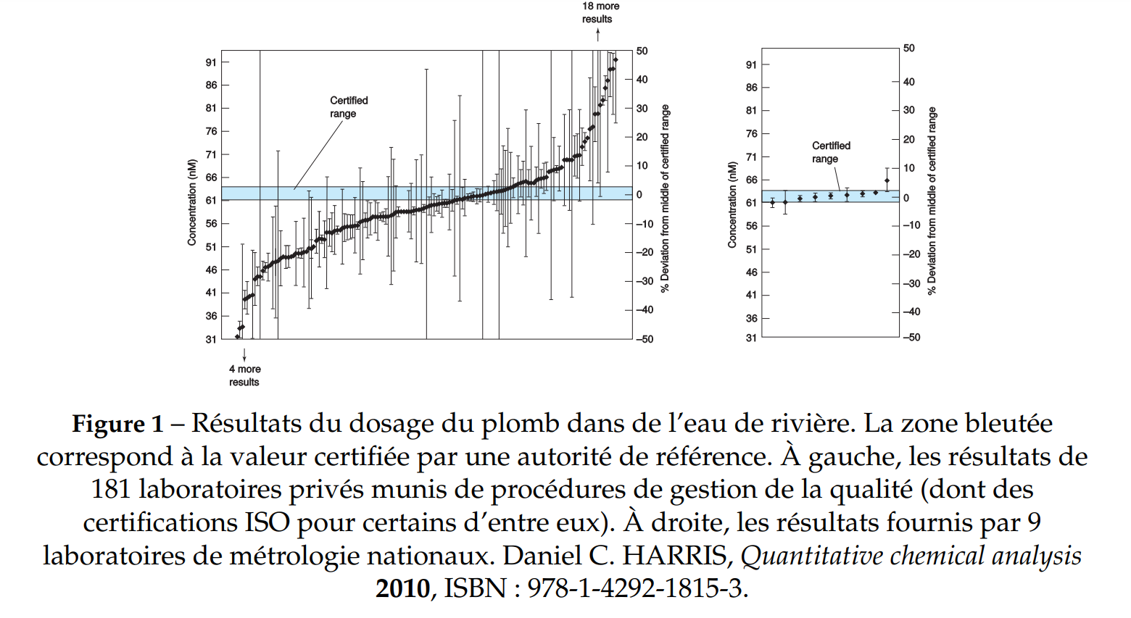
Introduction :

Slide 2
$$u_{z}=\sqrt{{\left(\frac{∂z}{∂x_{1}}u_{1}\right)}^{2}+…+{\left(\frac{∂z}{∂x_{k}}u_{k}\right)}^{2}}$$
$$u\left(\left[EDTA\right]\right)=[EDTA]\sqrt{{\left(\frac{u\left(m\right)}{m}\right)}^{2}+{\left(\frac{u\left(V\right)}{V}\right)}^{2}}$$
$$\left[EDTA\right]=\frac{m}{MV}$$

