Slide 1
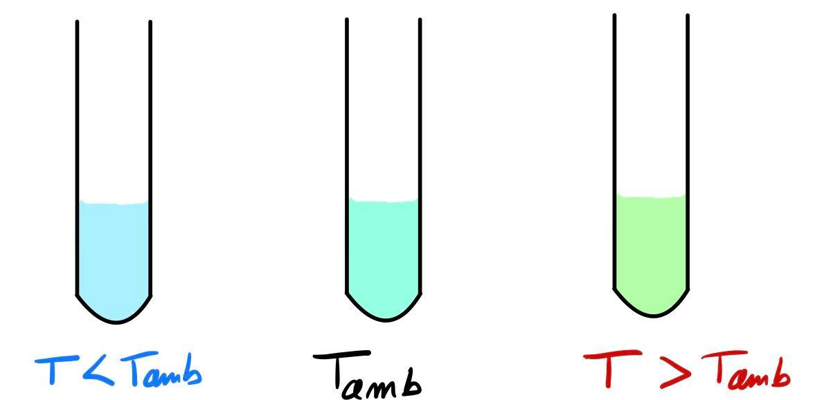
Introduction :

Slide 2
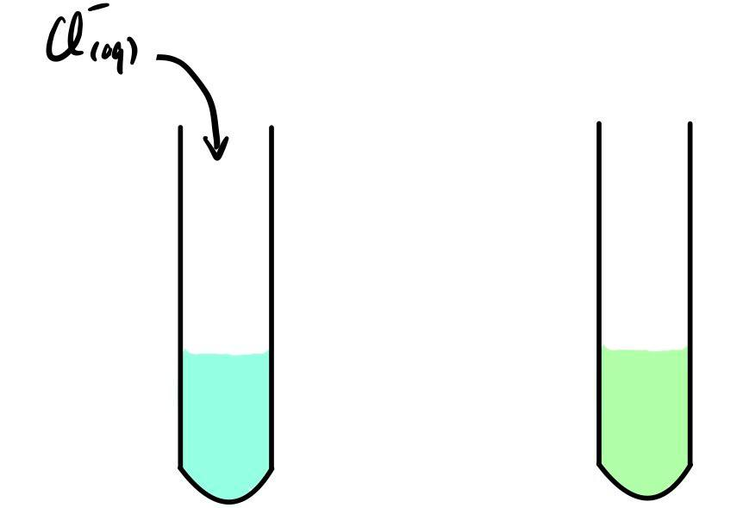
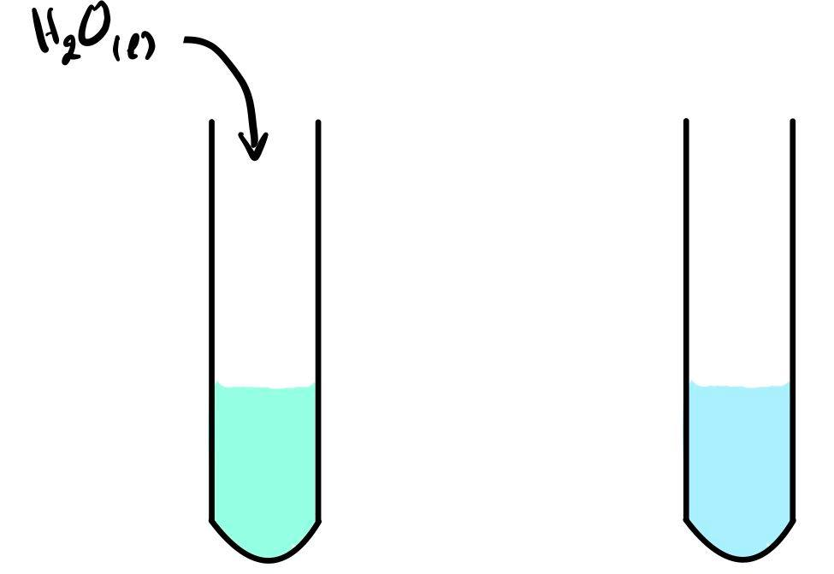
Introduction :
$${{\left[Cu{\left(H_{2}O\right)}_{6}\right]}_{\left(aq\right)}}^{2+}+4Cl_{\left(aq\right)}^{−}={{\left[CuCl_{4}\right]}_{\left(aq\right)}}^{2−}+6 H_{2}O_{\left(l\right)}$$

Slide 3
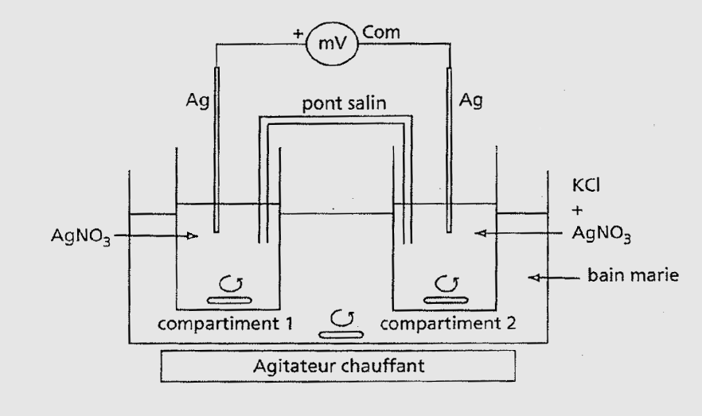
$$AgCl_{\left(s\right)}=Ag_{\left(aq\right)}^{+}+Cl_{\left(aq\right)}^{−}$$

