Slide 1
Exemples :
$$C{l_{2}}_{(g)}+2e^{−}=2Cl_{(aq)}^{−}$$
$$E_{Cl_{2_{\left(g\right)}}/Cl_{(aq)}^{−}}=E_{Cl_{2_{\left(g\right)}}/Cl_{(aq)}^{−}}^{o}+\frac{0.06}{2}\log{(\frac{P_{C{l_{2}}_{(g)}{C^{o}}^{2}}}{P^{o}{\left[Cl_{\left(aq\right)}^{−}\right]}^{2}})}$$
$$Ag_{(aq)}^{+}+e^{−}=Ag_{(s)}$$
$$E_{Ag_{\left(aq\right)}^{+}/Ag_{(s)}}=E_{Ag_{\left(aq\right)}^{+}/Ag_{(s)}}^{o}+\frac{0.06}{1}\log{(\frac{\left[Ag_{\left(aq\right)}^{+}\right]}{C^{o}})}$$

Slide 2
Exemple important :
$$αOx+γH_{(aq)}^{+}+ne^{−}=βRed$$
$$E_{Ox/Red}=E_{Ox/Red}^{o}+\frac{0.06}{n}\log{(\frac{a_{ox}^{α} }{a_{Red}^{β}}\frac{{\left[H_{\left(aq\right)}^{+}\right]}^{γ}}{{C^{o}}^{γ}})}$$
$$Mn{O_{4}}_{(aq)}^{−}+8H_{(aq)}^{+}+5e^{−}=Mn_{(aq)}^{2+}+4H_{2}O_{(l)}$$
$$E_{Mn{O_{4}}_{\left(aq\right)}^{−}/Mn_{(aq)}^{2+}}=E_{Mn{O_{4}}_{\left(aq\right)}^{−}/Mn_{(aq)}^{2+}}+\frac{0.06}{5}\log{(\frac{[MnO_{4_{(aq)}}^{−}] }{[Mn_{(aq)}^{2+}]}\frac{{\left[H_{\left(aq\right)}^{+}\right]}^{8}}{{C^{o}}^{8}})}$$

Slide 3
Exemple :
$$Fe_{(aq)}^{2+}=Fe_{(aq)}^{3+}+e^{− }$$
$$Mn{O_{4}}_{(aq)}^{−}+8H_{(aq)}^{+}+5e^{−}=Mn_{(aq)}^{2+}+4H_{2}O_{(l)}$$
$$Mn{O_{4}}_{(aq)}^{−}+8H_{(aq)}^{+}+5Fe_{(aq)}^{2+}=Mn_{(aq)}^{2+}+5Fe_{(aq)}^{3+}+4H_{2}O_{(l)}$$
$$E_{Mn{O_{4}^{−}}_{\left(aq\right)}/Mn_{(aq)}^{2+}}^{o}=1.51 V$$
$$K^{o}\left(25°C\right)={10}^{\frac{5}{0.06}(E_{Mn{O_{4}^{−}}_{\left(aq\right)}/Mn_{(aq)}^{2+}}^{o}−E_{{Fe}_{\left(aq\right)}^{3+}/{Fe}_{(aq)}^{2+}}^{o})}$$
$$E_{{Fe}_{\left(aq\right)}^{3+}/{Fe}_{(aq)}^{2+}}^{o}=0.77 V$$
$$K^{o}\left(25°C\right)≃4,6×{10}^{61}$$

Slide 4
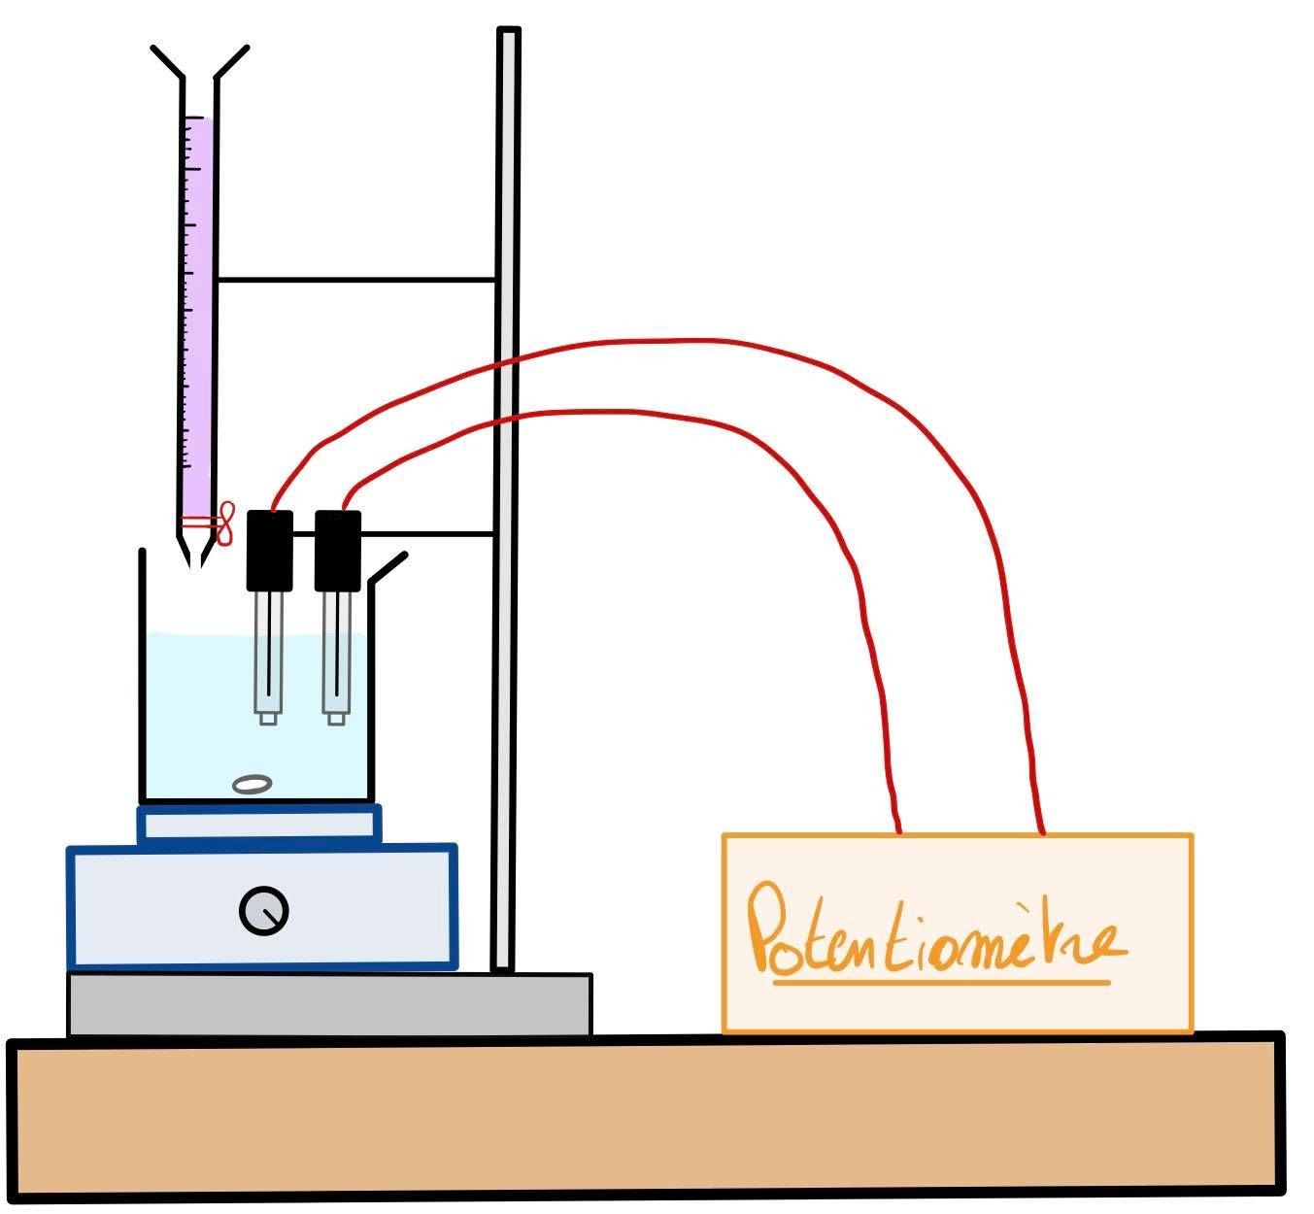
Titrage potentiométrique :

