Slide 1
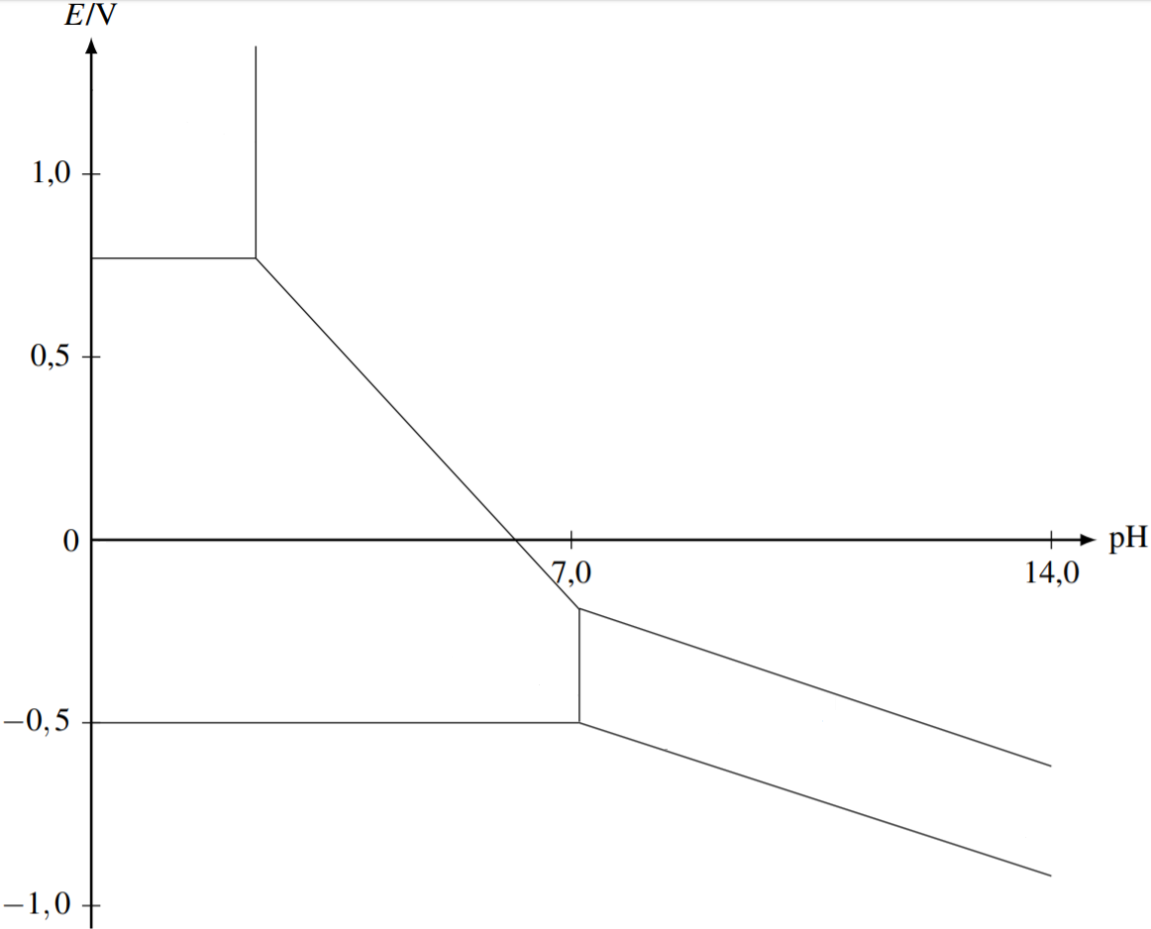
c(tra) =0.01 mol/L
Fosset (Dunod)

Slide 2
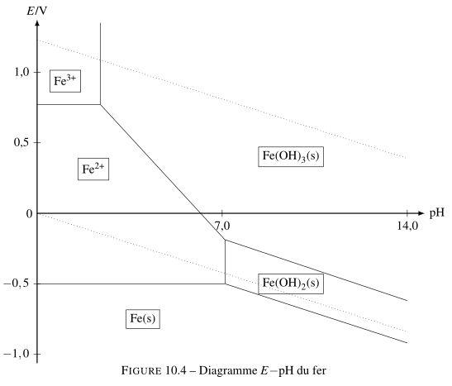
c(tra) =0.01 mol/L
Fosset (Dunod)

Slide 3
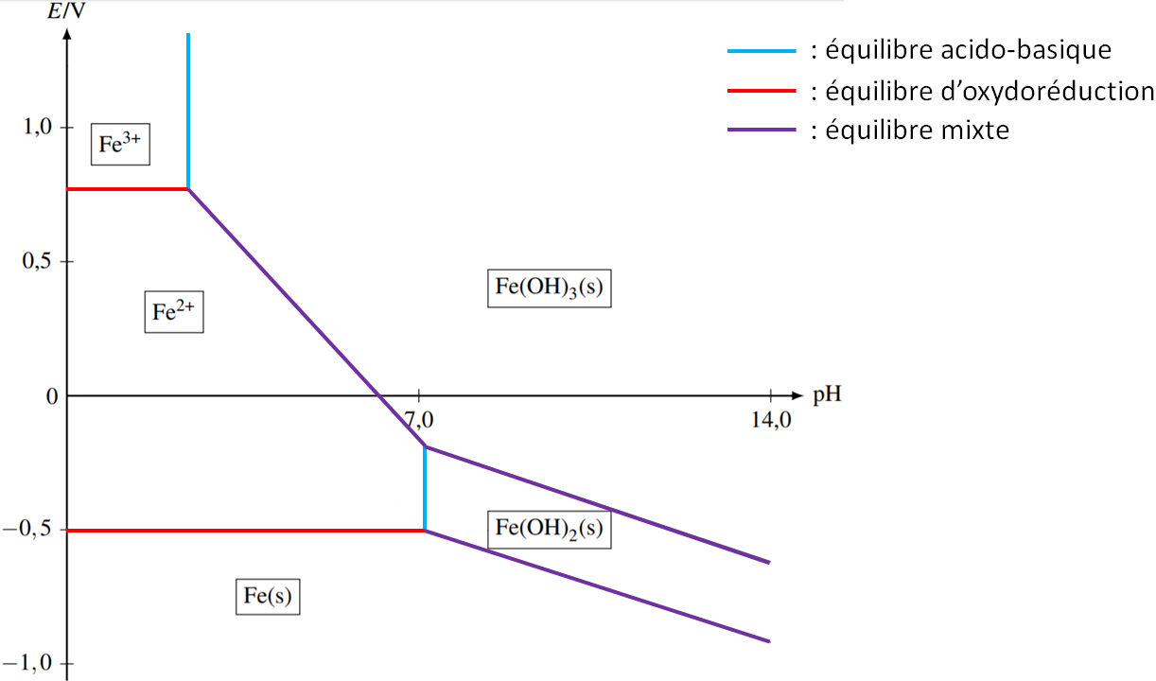
c(tra) =0.01 mol/L
Fosset (Dunod) , B. Blancon, V. Martos

Slide 4
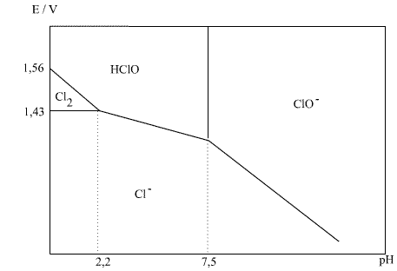
convention : concentration totale en chlore de 0.1 mol/L
http://www.sciences-en-ligne.com/

Slide 5
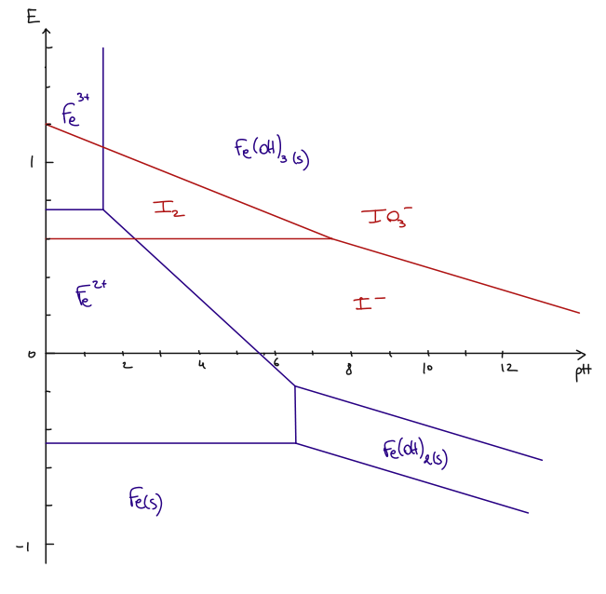
c(tra) = 1 mol/L

Slide 6
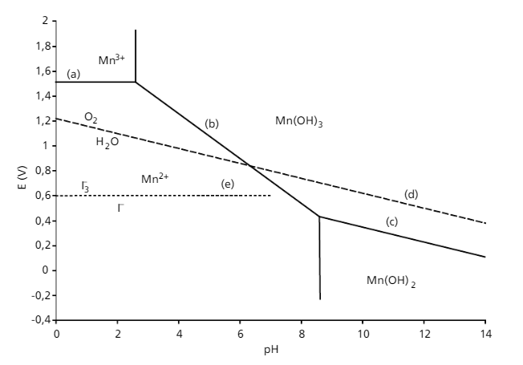
Mn
I
(3)
O2
(4)
(2)
(4)
(2)
(1)
Porteu-de-Buchère

Slide 7
selon Cachau-Hereillat

Slide 8
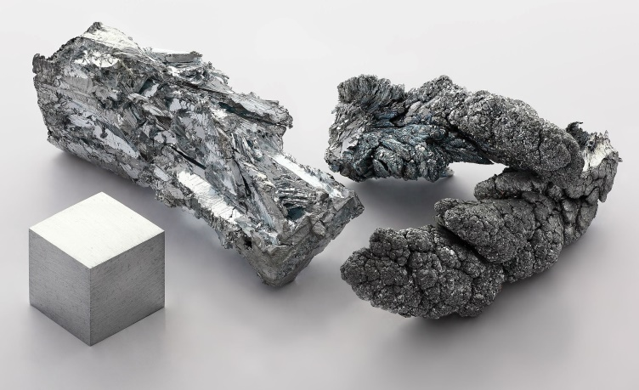
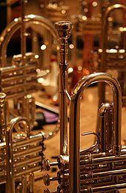
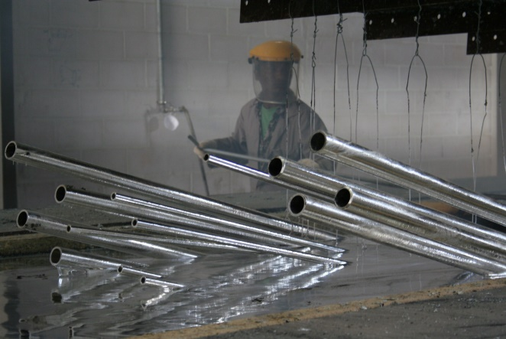
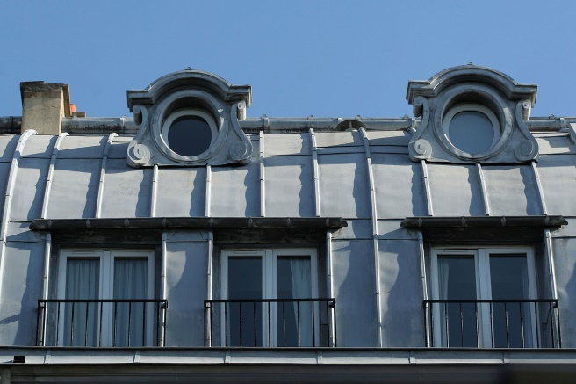
Zinc (Z=30)
galvanisation (à chaud)
couverture des toits (bvd St Michel, Paris)
laiton (alliage cuivre-zinc)

Slide 15
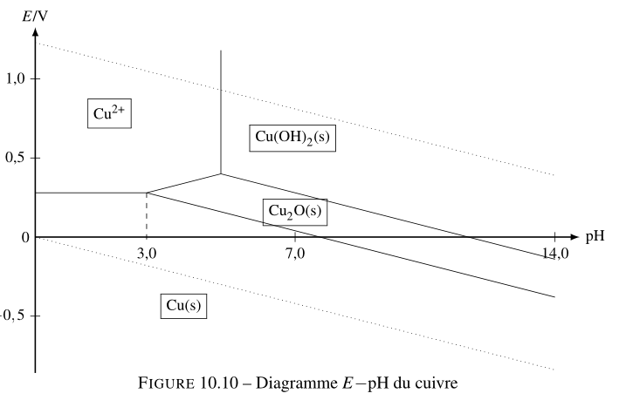
c(tra) =0.01 mol/L
Fosset (Dunod)

Slide 16
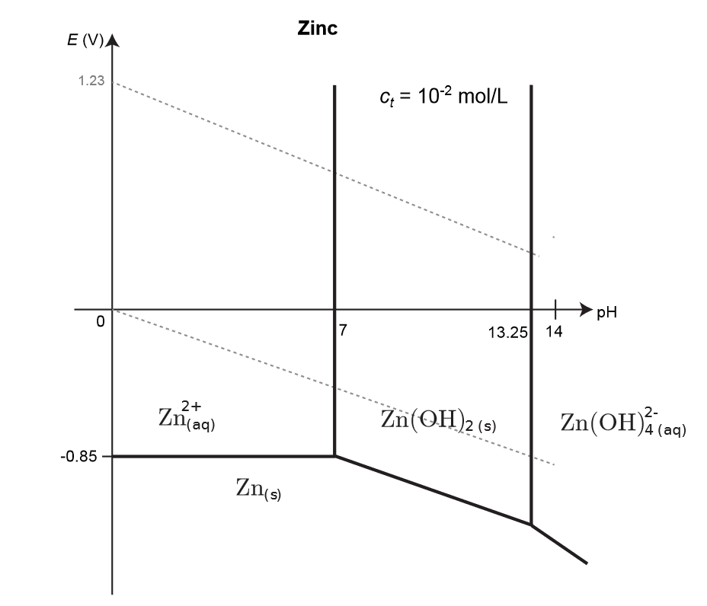
M. Melzani

Slide 17
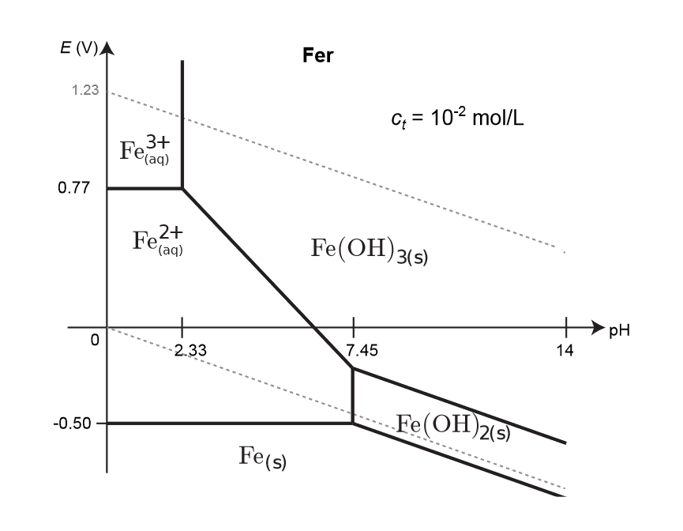
M. Melzani

